Slide 1
Women sportscasters
Anastasija Cumika
Savannah Daw

Slide 2

Erin Jill Andrews
Andrews was born on May 4, 1978 in Lewiston, Maine, USA. She an American sportscaster, journalist, and television personality.

Slide 3
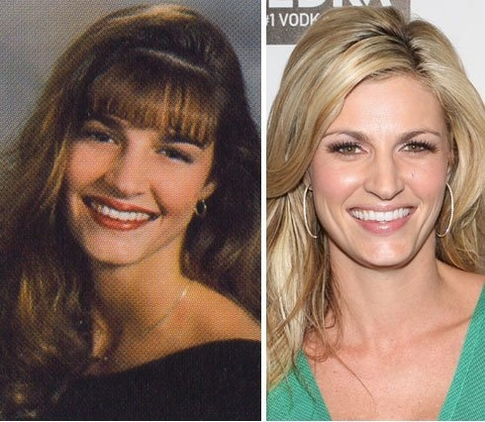
Education
Bloomingdale High School in Valrico, Florida. Graduated from high school in 1996.
University of Florida. Graduating in 2000 with a Bachelor of Arts (BA) degree in Telecommunications

Slide 4
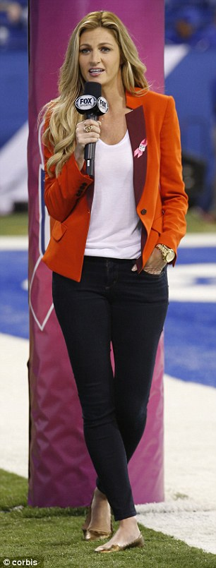
Career
She began her career In 2000, when Andrews was employed by Fox Sports Florida as a freelance reporter.
In 2001–2002 she served as a Tampa Bay Lighting reporter for the Sunshine Network.
From 2004 till 2012 she was working at ESPN. She was a reporter at several programs such as ESPN National Hockey Night, ESPN College Football Saturday Primetime and etc.
At 2012 she joined FOX Channel and She currently hosts FOX College Football for Fox Sports.

Slide 5

Interesting facts
Got nomination for Teen Choice Award as a TV Personality: Female for FOX Sports
Her father Steve is a six-time Emmy Award–winner. Now he is reporter for WFLA-TV News Channel 8 in Tampa Florida.
Andrews was voted "America's Sexiest Sportscaster" by Playboy in 2007 and 2008.
Andrews competed on the tenth season of ABC's Dancing With the Stars with professional partner Maksim Chmerkovskiy.

Slide 6

Hannah Lynn Storm
Hannah Lynn Storm was born on June 13, 1962 in Oak Park, Illinois, USA. She is journalist, producer and director, a pioneer in the field of sports broadcasting for women, an advocate for children’s issues, and a published author.

Slide 7
Education and career start
Graduated from the Westminster Schools of Atlanta in 1979.
Attended the University of Notre Dame and graduated in 1983 with degrees in communications and political science.
Storm's national television experience began as the first female host of CNN Sports Tonight from 1989 – 1992 .

Slide 8
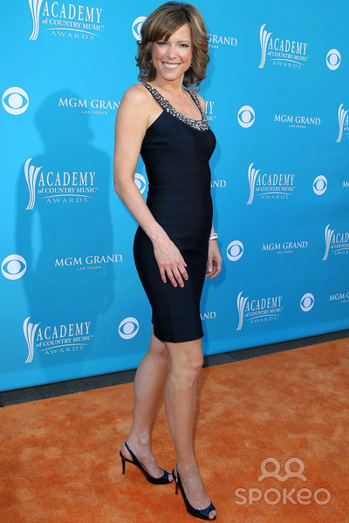
Career
She worked for 10 years (1992 - 2002) at NBC Sports, where she hosted four Olympic Games.
Storm worked at CBS News for five years (2002 – 2007) as a host of “The Early Show,” She also served as co-host of the network’s “CBS Thanksgiving Day Parade”.
Currently Storm hosts the weekday edition of ESPN’s Sports Center, and during the NFL season, hosts the Sunday edition of Sports Center, leading into ESPN’s NFL coverage.

Slide 9
Awards and interesting facts
The "Celebrated Mom" Award in May 2011.
Storm received the 2011, 2012,2013 Gracie Award®
Called the longest tennis match in history - 11 hours, 5 minutes spread over 3 days.
Storm is the author of two books: "Notre Dame Inspirations," and "Go Girl!: Raising Healthy, Confident and Successful Daughters through Sports“
Created the Hannah Storm Foundation, which assists children who are born with vascular birthmarks.
Storm has also appeared in feature films “Like Mike” and “Valentines Day”, in addition to television series “Arlil”, “Scrubs” and “As the World Turns”.

